Slide 1

How to Add “Fade” Transition
Microsoft PowerPoint
Ryan Nguyen

Slide 2


Slide 3


Slide 4
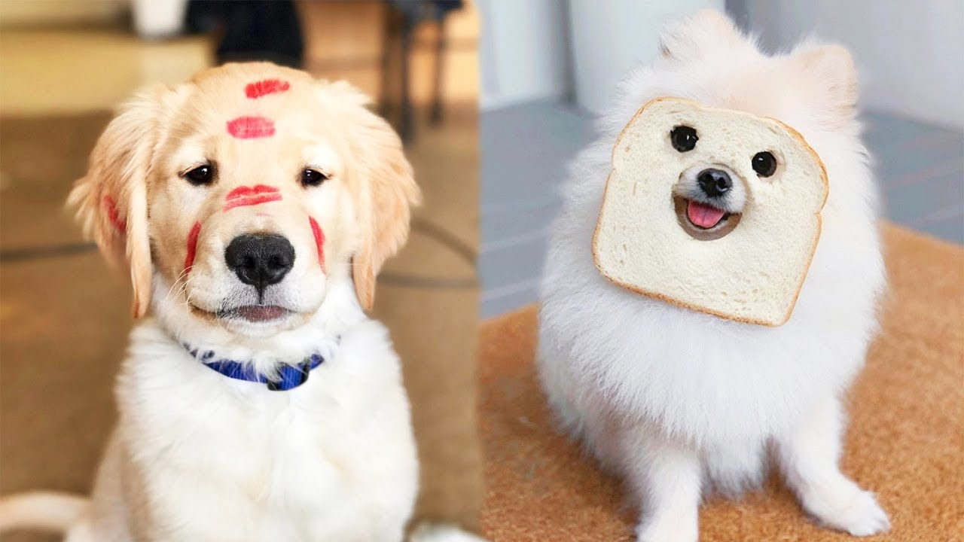

Slide 5


Slide 6


Slide 7
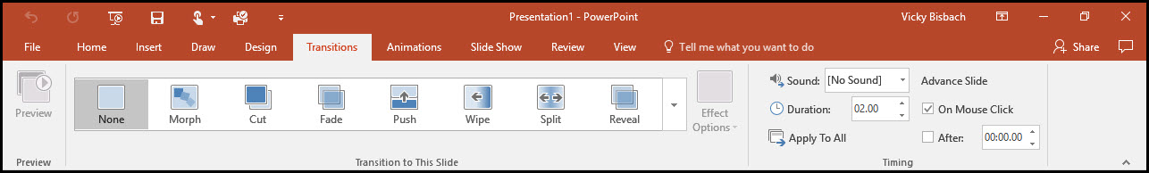
How to Add “Fade” Transition
Click on your transitions tab and select “Fade”

Slide 8
How to Add “Fade” Transition
Apply desired duration amount in seconds.
Ability to apply transition to all slides.
Option to use sounds with transition.

Slide 9
How to Add “Fade” Transition
Advanced Options
Uncheck “On Mouse Click” if you would like your transition to happen automatically.
Check “After” box and select duration time for automatic transition.

Slide 12
PowerPoint Transition Effect “Fade”
3.
Advanced Features
Transition on click
Auto transition after set amount of time
2.
Select duration amount in seconds
Ability to apply transition to all slides
Sound effect if desired
Simply click on the “Transitions” tab and select “Fade”
Power Point Fade_Ryan_Nguyen_Nov2019

